Slide 1
Tehachapi Renewable Transmission Project Chino Hills Section
Presented By: Brian Montgomery, Pearl Baghel, Roberto Blanco

Slide 2
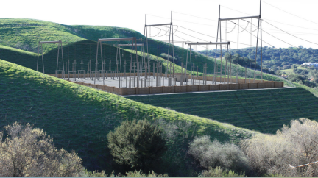
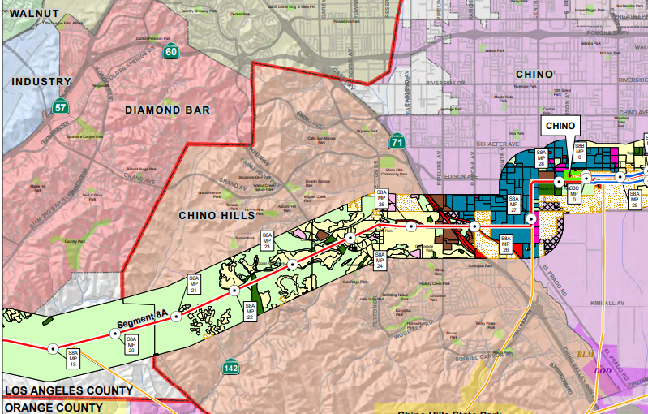
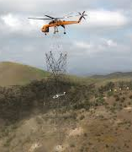
Background
Notes:
For those of you who don't yet know about the Tehatchapi project, it is a clean energy initiative to create and transmit clean energy from an area just south of the Sierra Nevada mountains to southern california.
One of the most challenging portions of this project was installing the energy infrastructure to bring this power across the Santa Ana mountains to the Inland Empire. The route this took was via the city of Chino Hills.
Despite controversy and residential pushback that threatened the completion of the project, our team at southern california edison has successfully completed this project and the lines are now in service transmitting high voltage energy that powers your homes, apartments, and yes, even your colleges.
Now that we are caught up, my colleagues and I would now like to present the findings of our post-project audit.

Slide 3
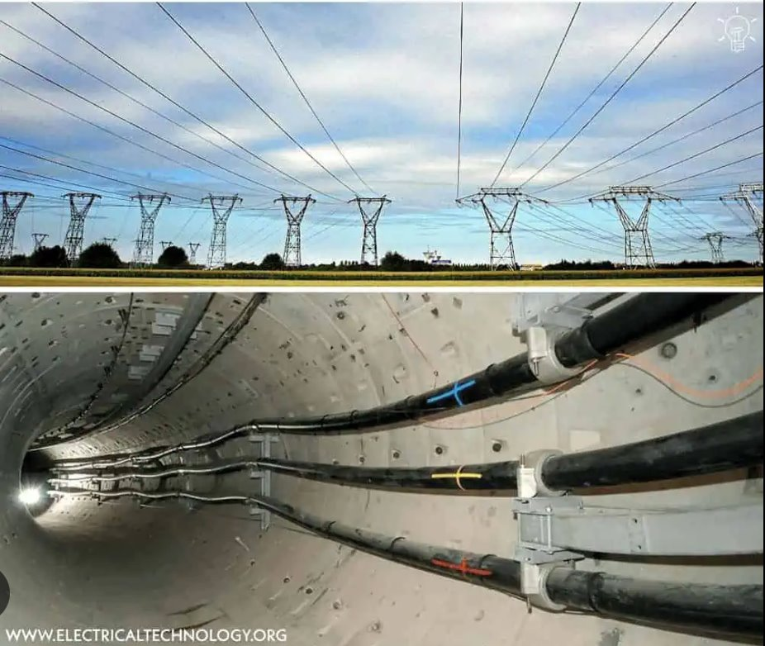
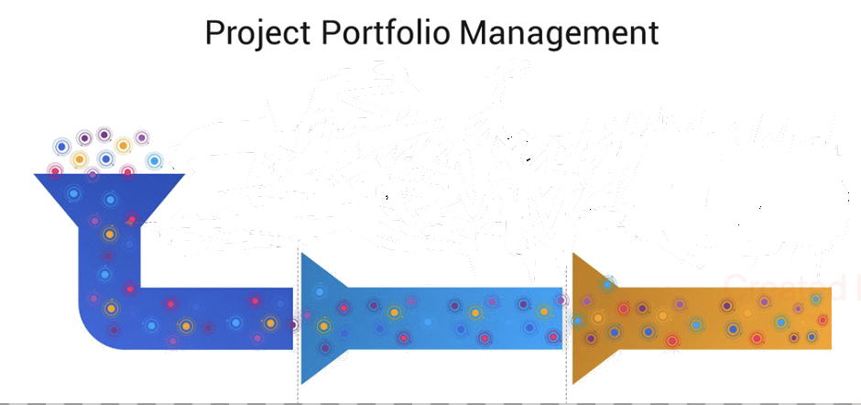
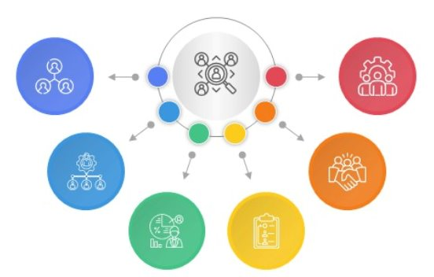
Project Key Findings
Exploring Options: Overhead vs. Underground
Stakeholder Communication
Multi-Project Environment Challenges
Notes:
In our key findings, first it's our decision making process. We noticed right from the beginning that it was worth our time to explore all options, even when the correct option might be obvious. We explored building the line either Overhead or Underground. Both options has their own set of pros and cons, with different budgets, schedules and risks. Do we build the line Overhead which is our bread and butter or do we go Underground which is a novel design. For reasons of cost, feasibility and time, we chose to go Overhead. By looking at the bigger picture, we were able to make a better decision.
This brings me to the next finding. "The importance of Stakeholders engagement" Some of our key stakeholders were the City of Chino Hills, CPUC, and internal teams. In a high visibility project like this one, Stakeholder engagement from the beginning, it's not an option, it's mandatory. This included 1-1 meetings with resources that fall in the critical path. So regular check-ins, clear updates and keeping the communication steady helped to avoid surprises and built trust.
The last finding has to do with the dynamics of working in a multi-project environment. Teams work across similar projects, and having similar scopes has its advantages. The most obvious advantage being knowledge transferred is great. Lessons learned from one project could be applied in another project. At the same time, from a PM standpoint, sharing resources and juggling schedules with similar operating dates create pressure. We were very aware that delays in one project, could cause a Domino's effect on the pipeline. We knew that careful planning and coordination was more important than ever. A PM in this situation has to always look ahead, stay flexible and understand resources limitations.
These findings could shape our approach and help us move forward with more clarity and confidence with future projects.
Purpose of insights: To improve how SCE makes decisions, aligh stakeholders and coordinate shared resources so future projects deliver with more certainty and fewer risks.
Explore all options: Overhead VS. Underground
Cost, Constructability and community impact
Looking at the full picture = better decisions.
Stakeholders: Many groups involved
Clear, steady communication
Keep everyone aligned
Include right people at the right time
Builds trust + avoids surprices
Multi-project environement: Teams work across similar projects
Shared experience = faster problem solving
But shared resources = pressure
Delays can have a Domino's effect
Coordination + planning are key. The overhead vs. underground decision involved a balanced look at cost, schedule constraints, environmental impacts, and long-term performance. While overhead construction is typically more cost-efficient and quicker, community sensitivity and permitting considerations required an in-depth comparison to ensure compliance with CPUC expectations. Our communication plan with CPUC, the City of Chino Hills, environmental regulators, and local residents ensured transparency, especially during permitting and ROW negotiations. This reduced rework, which directly supported performance indicators like SPI and CPI later in the project SCE’s multi-project environment meant our crews, designers, and inspectors were also supporting other transmission projects. Using the RSCI chart, we prioritized resources based on risk, schedule impact, and criticality. This allowed us to maintain performance metrics within acceptable limits.

Slide 4
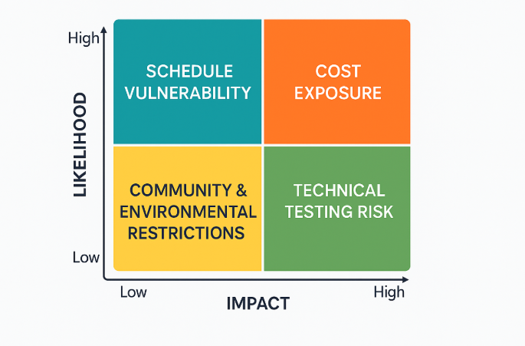
Key Risk Factors
Notes:
Before moving into our performance metrics, it’s important to briefly highlight the core risk factor.
First, we had schedule risk, which occurred mainly because of the dependencies and coordination challenges with other SCE projects using the same engineering and construction resources as it is a multi project company Even a small delay here could impact the full timeline.
Second was cost exposure, especially since we had very specific requirement for our project procuring the material with any price fluctuations and potential scope adjustments was little risky. This required tight change management and clear approval pathways.
Third, as we worked within community and environmental restrictions, including limited work hours, noise controls, and dust-mitigation requirements in the Chino Hills residential corridor. These constraints influenced both planning and daily operations.
Lastly, there was technical testing risk, specifically related to high-voltage cable testing and commissioning. While the likelihood was low due to strong QA processes, the impact of any issue would be significant.
Since we had a proper mitigation plan none of these risk affected us. Understanding these risks will help you understand the performance metrics shown next and helps explain why our cost and schedule controls were so critical throughout the project.

Slide 5

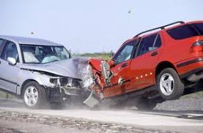
Performance Metrics Overview
Cost – Underbudget
Schedule – Ahead of schedule
Why?
Overhead vs underground
Leveraging Crashing Opportunities
Notes:
Cost: We worked within a CPUC-approved $18.2M budget. Key cost categories were procurement of the 500kV cable, tower construction, civil activities, and specialized labor. Monthly cost tracking and milestone documentation reviews kept spending under control.
Schedule: The project spanned roughly 5.2 years. Permitting and environmental compliance formed the early critical path, followed by design, tower construction, pulling, splicing, and testing. Regular schedule reviews kept us aligned with CPUC’s 6-year mandate.
How were we so far underbudget and ahead of schedule?
Two reasons:
First, we had a larger budgeted schedule and cost due to the fact that at the time we were awarded the contract, the CPUC had not yet made a ruling on whether the project could be done above ground. As such, the project needed to be planned for the worst case scenario and could have averrun the budget if the CPUC changed their ruling after the project was underway.
Second, we took advantage of opportunities to crash the schedule. This was especially useful in our multi-project environment where resources could unexpectedly disappear or free up for brief periods of time.

Slide 6
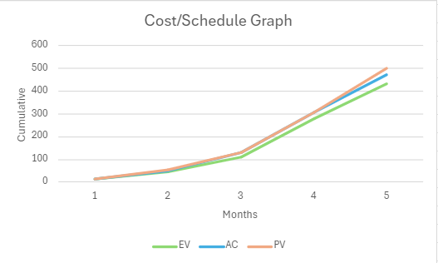
Performance Metrics Overview
Tracking performance through Metrics
EV, PV, AC, SPI, and CPI
Quality
Incorporating the environmental and company policy
Notes:
Next you will see how we used our Schedule performance index and cost performance index reflected our projects progress
Looking at the earned value curve which is slightly below the Predicted value we can determine that we were just a little behind schedule, but the difference was small enough keeping us essentially on track
In the same way if we look at the Actual cost which is slightly above Earned Value you can say our cost performance index, is also close to 1.0, which means we were managing costs well with only minor variance.
Another factor that was important part of the metrics was Quality: Quality assurance is very important from SCE's point of view we followed SCE’s environmental policies, safety requirements, and system testing procedures which helped ensure reliability without causing major cost or schedule impacts. Overall, the metrics show controlled performance, minimal variance, and consistent quality throughout the project.

Slide 7

Recommendations
Use one shared repository for all project documents.
Audit documents at each milestone.
Align the team on project vision and scope.
Notes:
Next we have recommendations while working with SCE as project manager We did came up with some ideas which can be implemented more efficiently in there future projects 1. Use one shared repository for all project documents.
In our company we have multiple projects running altogether but also for any particular project like the Chino Hills Transmission lines, we had multiple teams working in parallel . Throughout the project, one challenge we experienced was that information was sometimes scattered across emails, personal folders, or separate team files. A central repository ensures everyone has the same information, the latest updates, and a clear record of changes Improving transparency and makes collaboration easier, especially when multiple resources are working on different projects & schedules. 2. Audit documents at each milestone. Another lesson from this project was how fast requirements were shifting whether it was environmental constraints or risk responses. When we reached new phases, we sometimes had to revisit earlier documents because something had changed.
Documentation of audits at milestones act like checkpoints preventing scope creep, improve change control accuracy, and reduce the risk of rework. . Because as the projects evolve requirements change, stakeholders may add constraints, or risks appear. If we don’t catch mismatches early, the cost and impact become much bigger later. 3. Align the team on project vision and scope.
Clear alignment is one of the biggest contributors to project success. For this project, We weren’t just building a transmission line we were delivering a critical segment of California’s renewable integration plan under CPUC oversight. That meant everyone needed the same understanding of why we were choosing certain design paths, what the scope truly included, and what the final deliverables had to meet. When the entire team understands the vision why we’re doing this project and what must be delivered it reduces confusion, prevents misinterpretation & avoid unnecessary changes & and keeps everyone moving toward the same goal. Since the project involves lots of teams and multiple stakeholders it was a little difficult at beginning that every factor is kept in mind and we don't get distracted from our project scope & vision the project was successful

Slide 8


Business Implications
Serving More Customers, Cheaper, Cleaner, and Sooner
Good Performance Translates to more Government Contracts
Large Scale Documentation Processes Enable Efficient Management of Future Projects
Notes:
Finally, we need to understand how these findings might affect southern california edison moving forward.
One of the obvious outcomes from this project is that southern california edison now has more capacity to serve the residents and businesses of southern california. We can now lower the costs of energy and emissions while serving more customers, and thanks to the governemnt footing much of the bill, SCE was able to complete this much faster than our organic growth trajectory would have allowed.
Also, due to our performance coming in under budget and ahead of schedule due to not needing to utilize all of the resources proposed for our alternate underground solution, we foresee that more govvernment contracts are likely to be awarded to southern california edison. A history of being able to deliver projects successfully can be incredibly valuable in swaying the final decisions on where contracts are awarded. Combine that with the high barrier for entry to our industry and we have a massive leg up on any would-be competition for government energy contracts.
Finally, our troubles with documentation and the solutions implemented during the course of this project will enable more efficient management of future projects and prevent disastrous errors of the same type from occuring on future projects.

Slide 9
Conclusion
“The real art of project management is turning complexity into clear decisions and coordinated effort.”
Notes:
And to wrap this up. We built a 2.3 miles Overhead powerline in the city of Chino Hills as part of the 273 miles Tehachapi Renewable Transmission Project that carries 3000MW from Windfarms in Tehachapi to Mira Loma. All this took us 2,142 days and $16.4 Million which was much less than was anticipated. In our key findings we discussed our decision making process to build the Powerline Overhead, our Stakeholder engagement and the dynamics of working in a multi-project environment. As part of our recommendations we talked about having a shared document repository, to audit each milestone and to make sure that everyone shares the same vision. Overall, these insights reinforce the value of better decisions + better alignment = better execution. These are practical lessons learned we can use in how we make business in the future. Finally, I'll leave you with this quote: "The real art of project management is turning complexity into clear decisions and coordinated effort".
Exploring options improved decision making (OH VS UG)
Communication kept stakeholders alighed
Multi-project environment: Shared experience + shared challenges
Key Recs: Shared repository, milestone audits, clarity on scope
Business value: faster renewable energy delivery, better market image, stronger documentation for future work.
Main message is: Better decisions, better alignment, better execution.

Slide 10

Q&A

